Slide 1
Introduction To MS_Excel
Excel is a software program created by Microsoft that uses spreadsheets to organize numbers and data with formulas and functions.

Slide 2
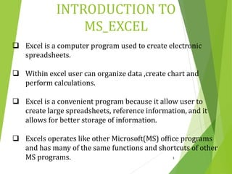

Slide 3
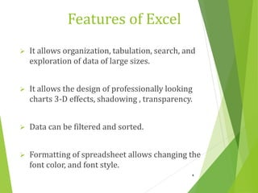

Slide 4
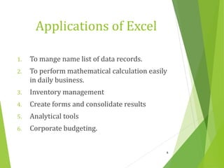

Slide 5
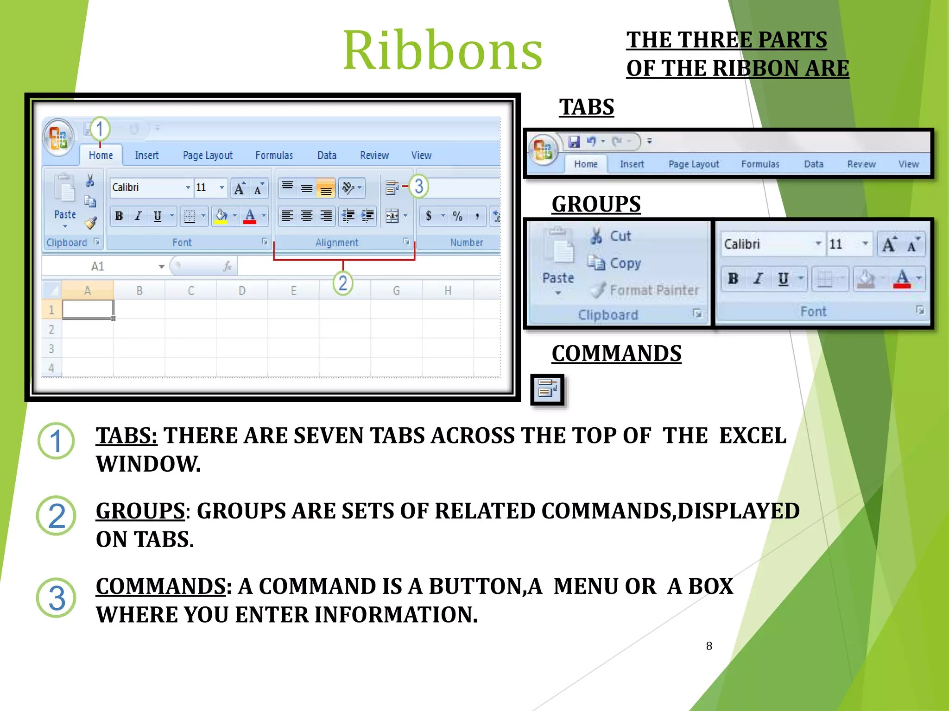

Slide 6
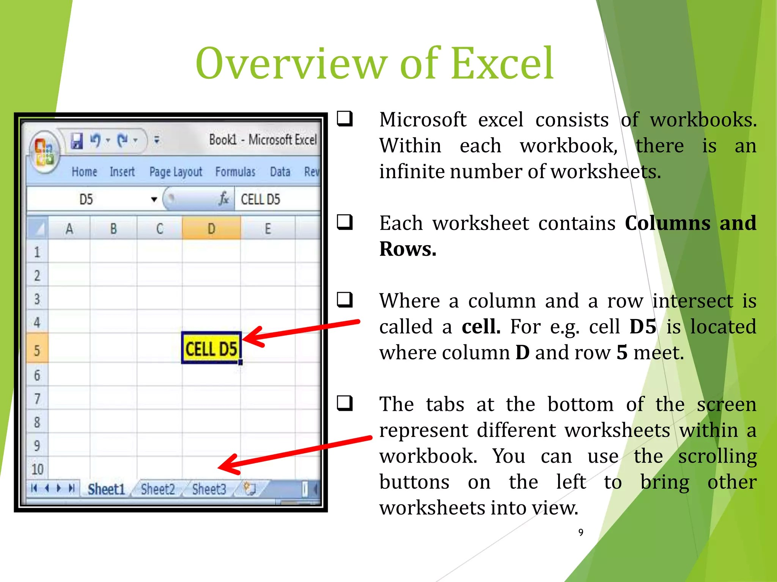

Slide 7
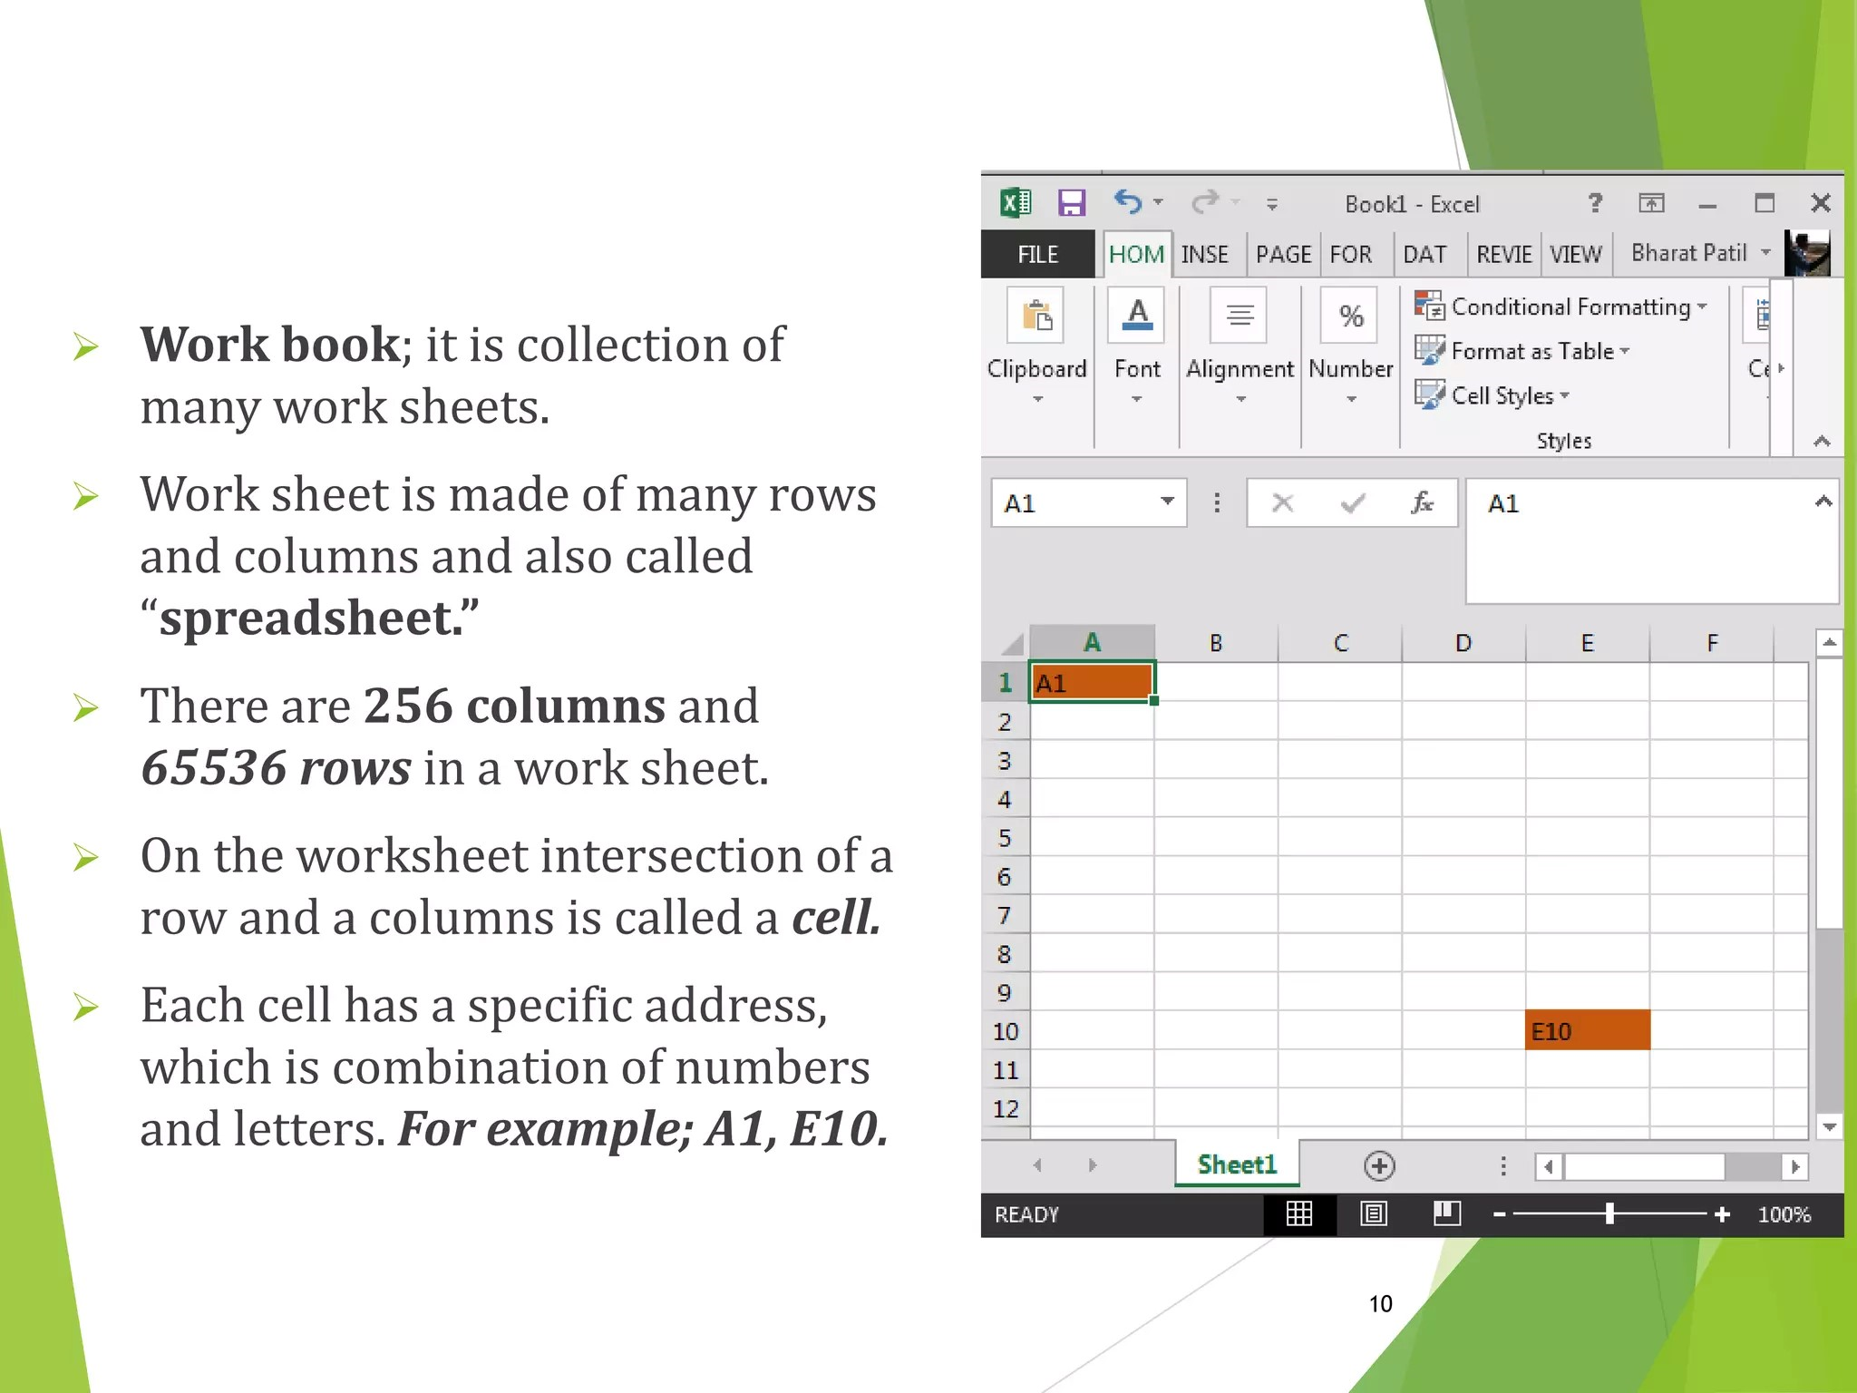

Slide 8
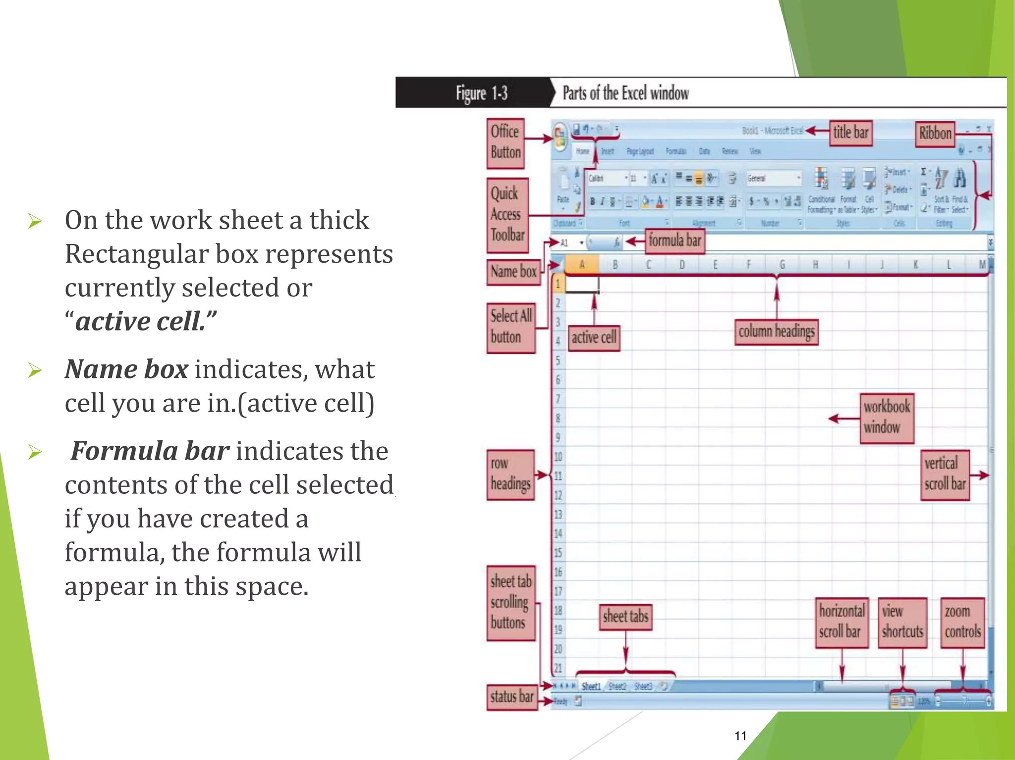

Slide 9
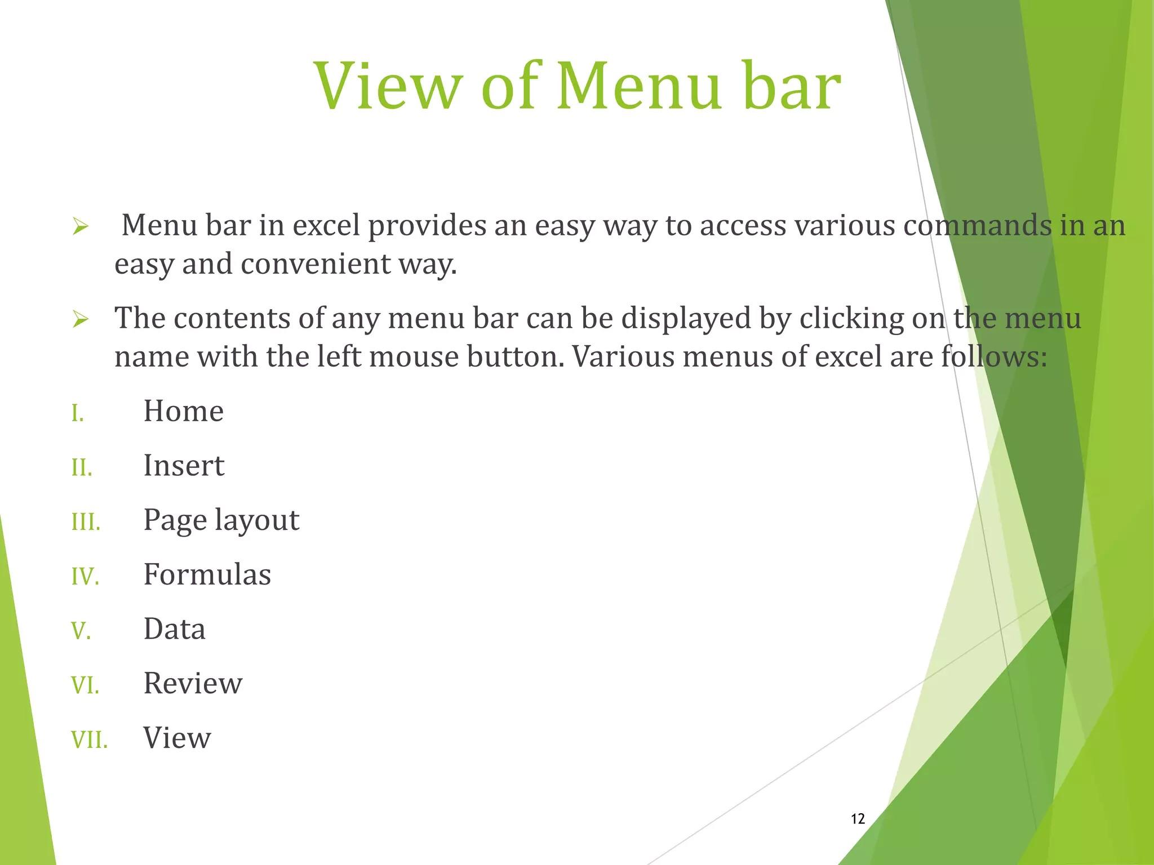

Slide 10
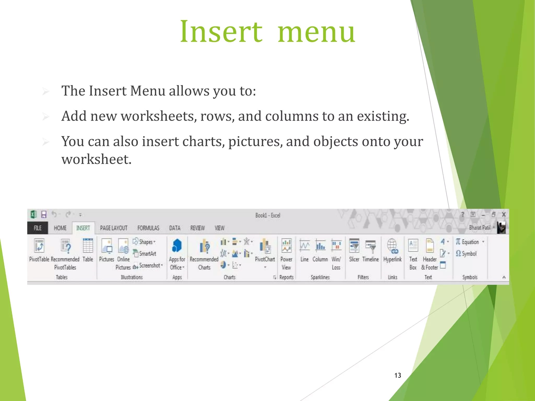

Slide 11
Introduction to MS_Word
Microsoft word is a word processor software developed by Microsoft in 1983.
It is used to create professional quality documents, letters, reports, resumes, etc and also allows you to edit or modify your new or existing document.

Slide 12
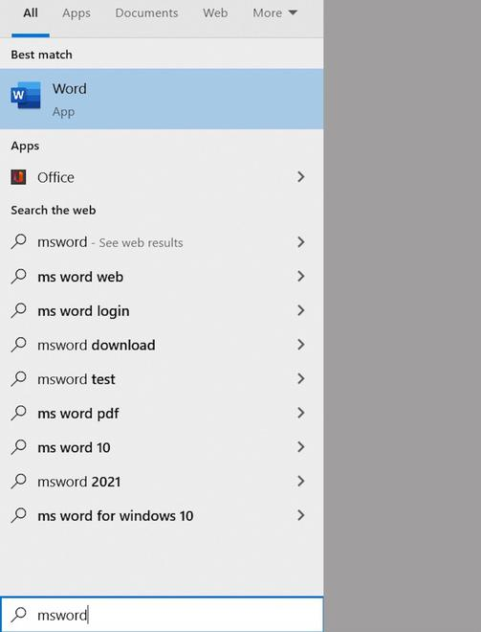
How to open MS Word?

Slide 13
How to open MS Word?
Step 1: Type Ms Word in the search bar.
Step 2: Select Ms Word application.
Step 3: Select a blank document and press create button.

Slide 14
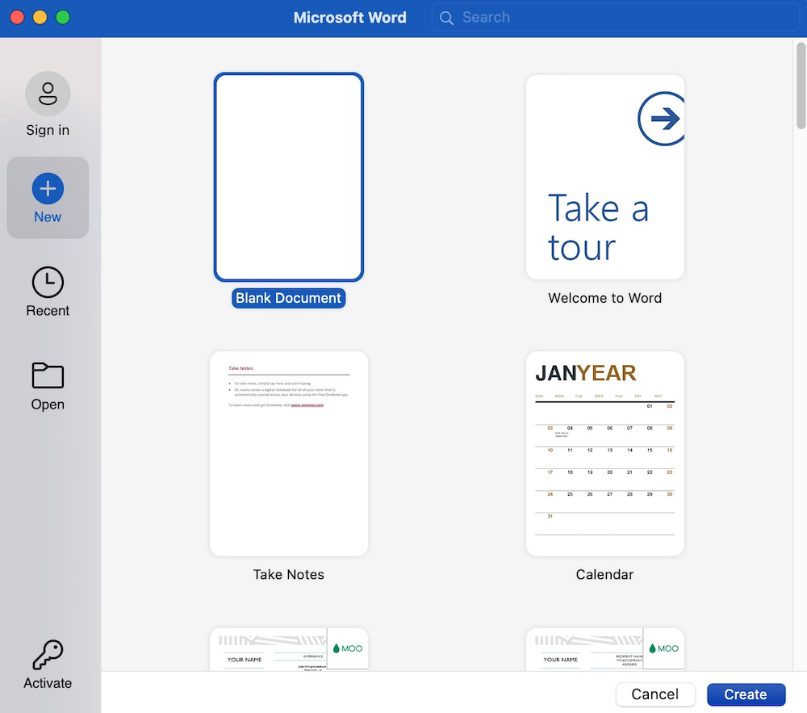

Slide 15
In Word you can write your content and perform different types of operations on that content, like font type, style, bold, italic, etc. You can also add images, tables, charts to your document.
Can perform different types of operations on your documents, like you can create, delete, style, modify, or view the content of your document.

Slide 16
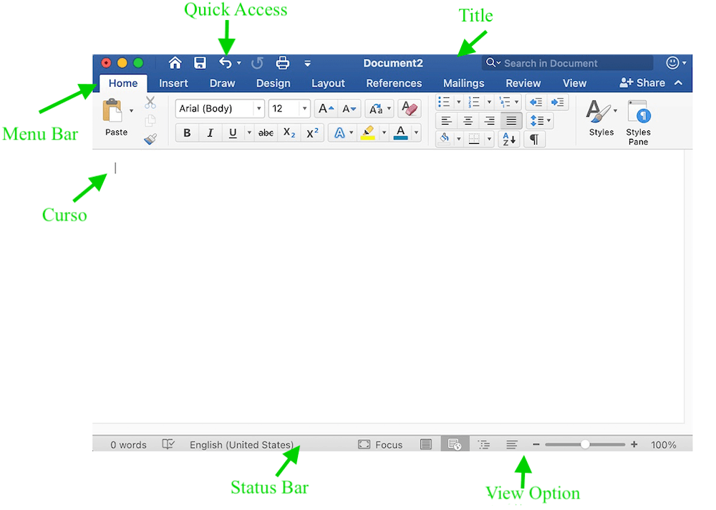

Slide 17
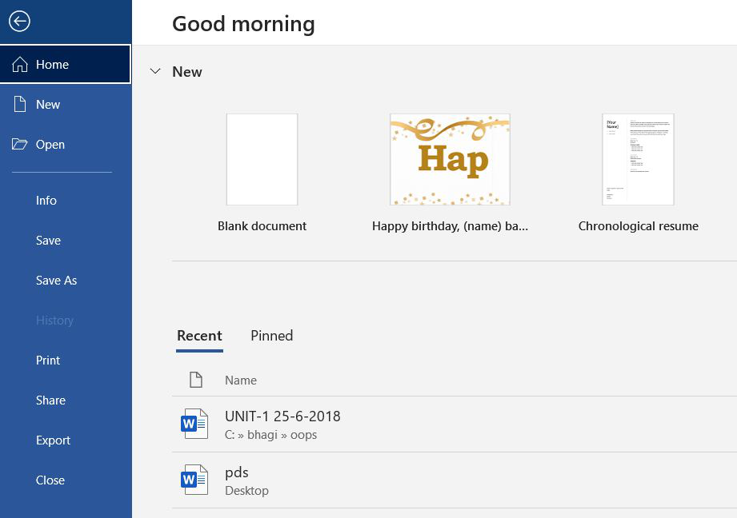
Features of MS Word

Slide 18
Features of MS Word
1. File:- New(used to create a new document),
Open(used to open an existing document),
Save(used to save document),
Save As(used to save documents),
History, Print, Share, Export, Info, etc.

Slide 19
Features of MS Word
Home:-
Home is the default tab of Ms Word and it is generally divided into five groups, i.e., Clipboard, Font, Paragraph, Style and Editing.

Slide 20
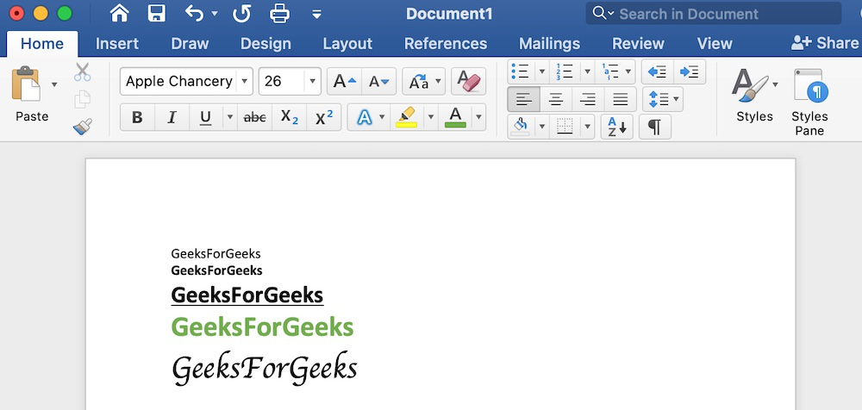

Slide 21
Insert Tab
Insert
It is the second tab present on the menu bar or ribbon.
It contains various items that you may want to insert into a Microsoft word.
It includes options like tables, word art, hyperlinks, symbols, charts, signature line, date and time, shapes, header, footer, text boxes, links, boxes, equations, etc.

Slide 22
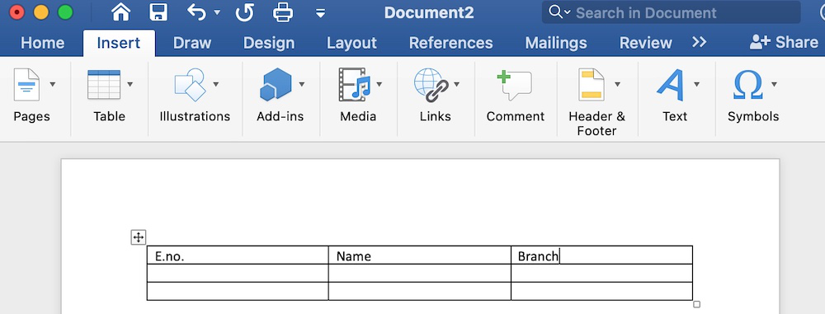

Slide 23
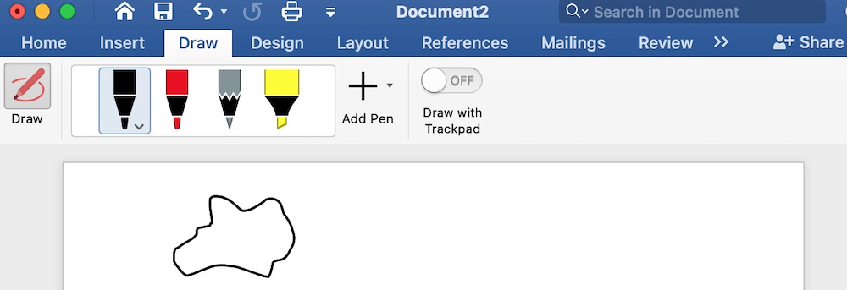
Draw It is the third tab present in the menu bar or ribbon. It is used for freehand drawing in Ms Word.

Slide 24
Design Tab
It is the fourth tab present in the menu bar or ribbon.
The design tab contains document designs that you can select, such as documents with centered titles, offset headings, left-justified text, page borders, watermarks, page color, etc.,

Slide 25
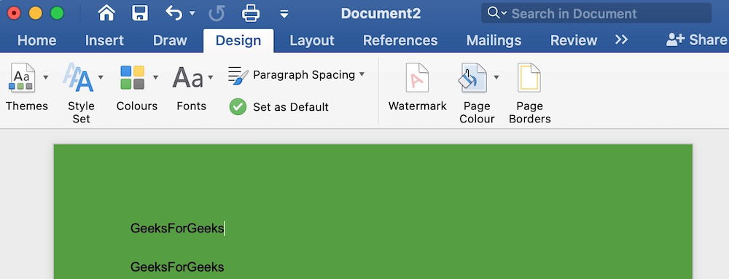

Slide 26
References Tab
It is the sixth tab present in the menu bar or ribbon.
The references tab lets you add references to a document, then create a bibliography at the end of the text.

Slide 27
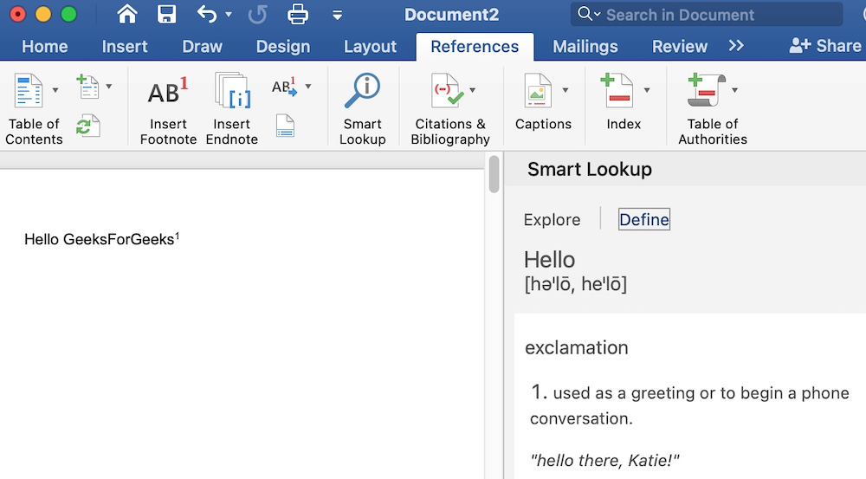

Slide 28
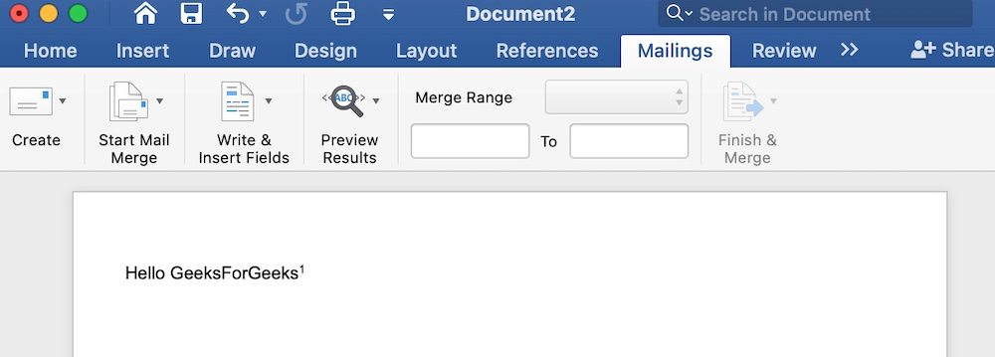
Mailings It is the seventh tab present in the menu bar or ribbon. It is a least used tab in the menu bar. This tab is where you would create labels, print them on envelopes, do mail merge, etc.

Slide 29
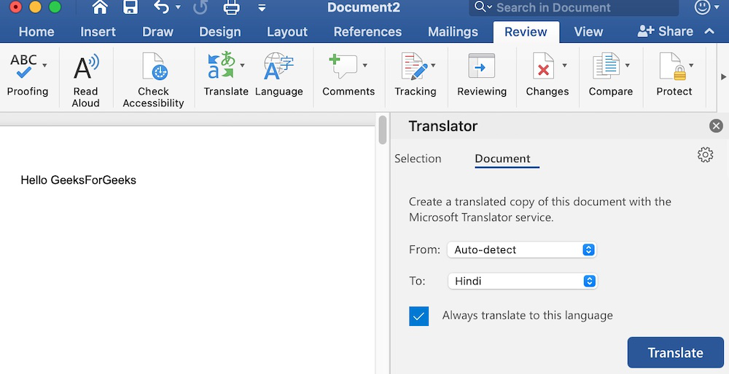
Review It is the eighth tab present in the menu bar or ribbon. The review tab contains, commenting, language, translation, spell check, word count tools. It is good for quickly locating and editing comments.

Slide 30
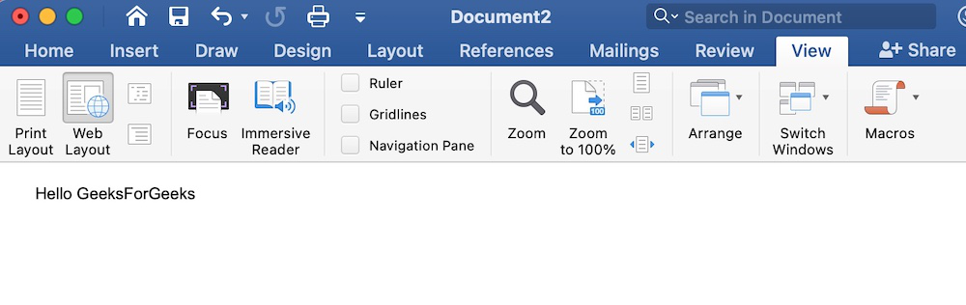
View View tab allows you to switch between single page or double page and also allows you to control the layout tools It includes print layout, outline, web layout, task pane, toolbars, ruler, header and footer, footnotes, full-screen view, zoom, etc.

